Slide 1
Augment Reality Based Learning Application for Children with Autism
Presented By
Karan M (720715104058)
Karthick Raja D (720715104060)
Karthik R (720715104061)
Karthik S (720715104062)
Project Guide
Mr.D.Magesh M.E.,
Assistant Professor

Slide 2
Abstract
People can learn through seeing (visually), hearing (auditorily), and/or through touching or manipulating an object (kinesthetically or 'hands-on' learning).
For example, looking at a picture book or reading a textbook involves learning through vision; listening to a lecture live or on tape involves learning through hearing.
Modern technologies delivers great educational tools to help physically challenged humans to learn and teach like Braille Reader and audio books for blind people.
But in the case of children with autism there are limited support available because of the difficulty in creating learning tool for them.

Slide 3
Some hyperactive autistic children do not know that speech is used for communication. Language learning can be facilitated if language exercises promote communication. If the child asks for a cup, then give him a cup.
This process is tedious, costly and not safe to handle for autistic children but creating virtual objects is cheap and safe to handle.
Hereby the developing application uses augment reality to interact with virtual object in real world so that children and even professionals can learn quickly and more interactively.

Slide 4
Existing System
Power Point Presentations
Audio Books
Video Tutorials
VR Simulators
3D Models Demos
Augment Reality for constructions and shopping

Slide 5
Drawbacks of Existing System
As far the developed educational application on AR Technology having limited functionality and lacks versatility and level upgrades.
Also most of the applications requires a QR Booklet and pre designed books to use AR on them.
Lack of a well structured syllabus to teach.

Slide 6
Drawbacks of Existing System
One - dimensional and is restricted to whatever the teacher will display on the projector screen.
Sometimes teachers use physical samples of cubes, spheres and other such shapes while teaching, to help students visualize the structure in a 3D space.

Slide 7
Proposed System
Using augmented reality to help the user understand the intricate concepts present in the static form of geometry, where the teaching and learning techniques are still limited to 2D visualization.
Use of Augmented Reality can complement a student’s understanding of 3D Geometry. Since it works directly in 3D, it will enable a user to comprehend the 3D Geometry concepts faster and better.
Develop game based syllabus to interact with virtual objects and apply motion animations to objects.

Slide 8
List of Modules
Phase 1:Identifing Image Target.
Phase 2:Selecting the Virtual Object
Phase 3:Placing Virtual object on Real World.
Phase 4:Applying Animation and Virtual Buttons for Interaction.

Slide 9
Description of Modules
Phase 1: Identifying Image Target.
In this module the target area for AR is chosen.
Target Area is either an Image or ground plane or QR booklet.
Printed Booklets with predefined images can also be target.

Slide 10
Description of Modules
Phase 2: Selecting the Virtual Object.
Based on the syllabus level virtual objects are created and compiled.
User can choose an object manually or the application itself arrange the objects automatically based on the lesson level.
Each object for each target will be choose.

Slide 11
Description of Modules
Phase 3: Placing Virtual objects in Real World.
With Vuforia AR Library virtual objects coordinates can be scaled, rotate and even can apply textures.
These virtual objects are then binded on top of the targets through the AR Camera.

Slide 12
Description of Modules
Phase 4: Applying Animation and Virtual Buttons for Interaction
To interact with virtual objects animations has to be applied.
Functionalities can implement using C# Scripts.
Creating virtual buttons and applying motion animations to the object.

Slide 13
Requirements
Hardware Requirements
Android / iphone
Intel i5 6th generation Processor
8 GB Ram
Software Requirements
Unity Game Engine
Vuforia AR SDK
Android Studio / xCode

Slide 14
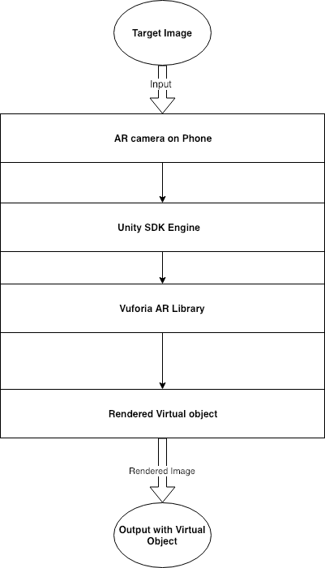
Block Diagram

Slide 15
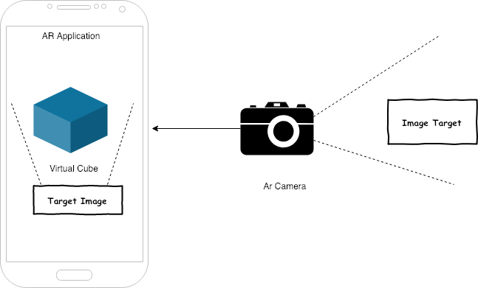
Architecture Diagram

Slide 16
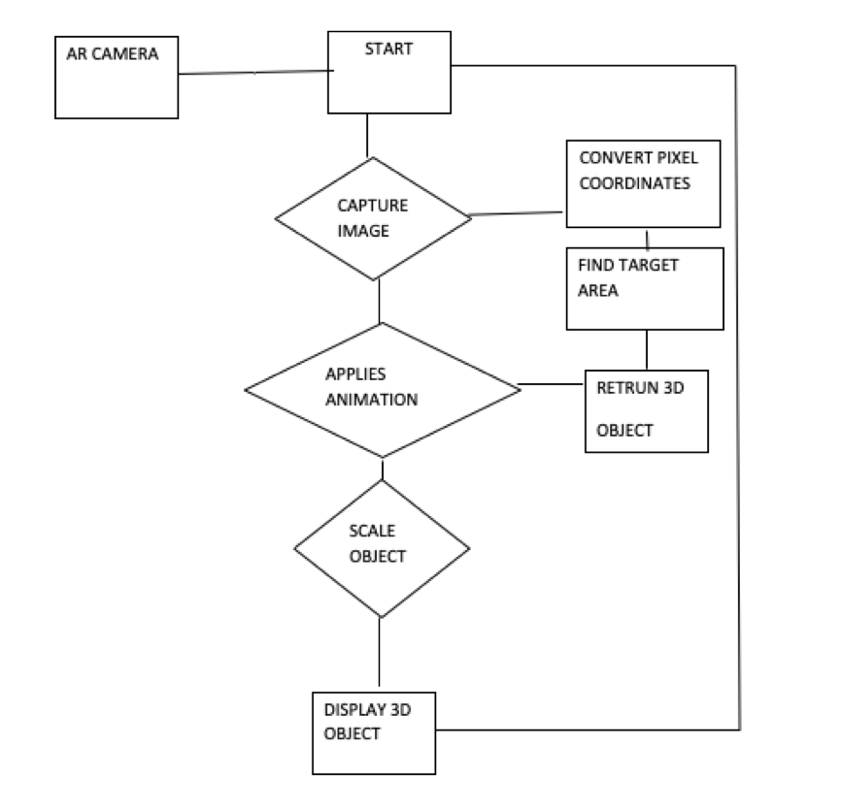
Activity Diagram

Slide 17
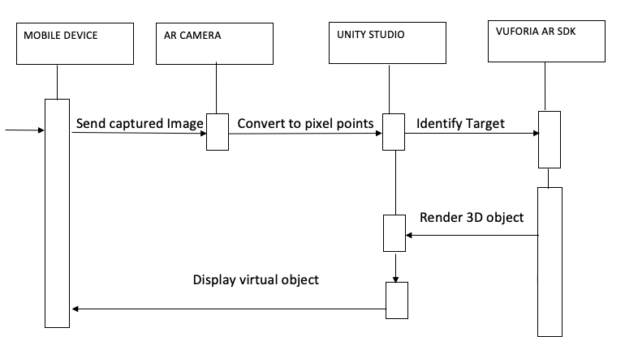
Sequence Diagram

Slide 18
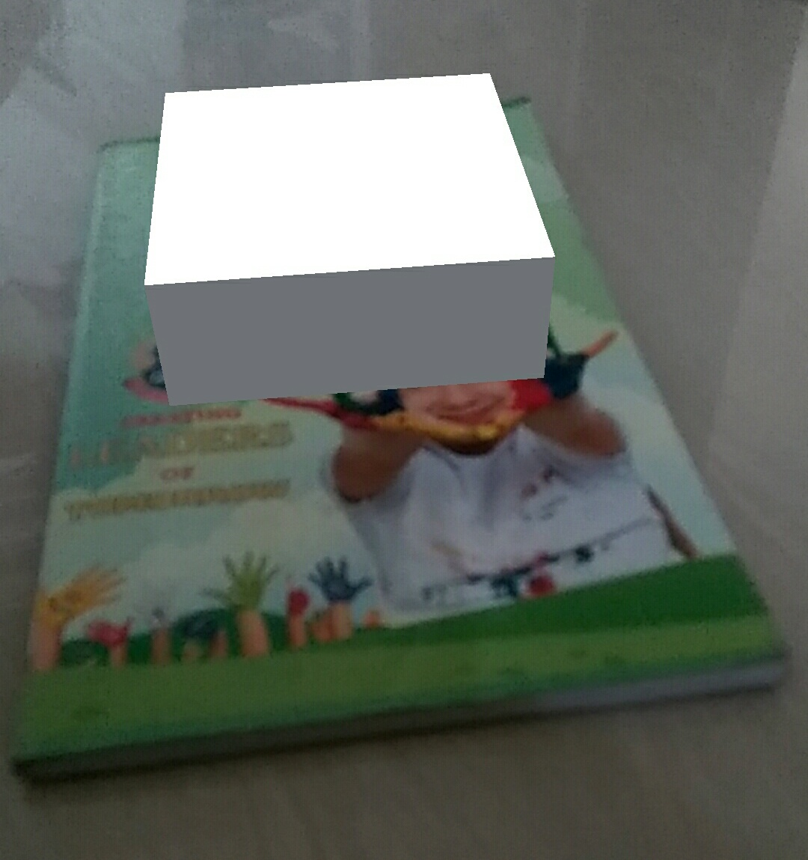
Implementation of Module 1
Image of the notebook is chosen as target in unity.
Simple 3d cube is made as the objective component.
C# Script is coded to scale and rotate the cube.
Finally compile the AR app through
Android Gradle.

Slide 19
Implementation of Module 2
In this module ground plane app configured and initialized using Vuforia C# API.
Vuforia ground plane supports three ground plane uses such as plane finding, mid air positioning, product placement.
By using plane finding various surfaces in our environment and augmented an object on these surfaces detected.

Slide 20
Implementation of Module 3
By using Ground-Plane virtual objects are placed in Mid-Air.
Multiple Image targets are assigned with different components.
Virtual objects are scaled to the coordinates so that user can
zoom the objects by moving the camera closer
to the virtual objects.

Slide 21
Implementation of Module 4
Interactions like animations and audio scripts are applied to each virtual objects.
C# scripts are bounded to the image targets and suitable audio clips are chosen for each virtual targets.
Automatic scaling and rotational movements are developed for both image targets and ground plane objects.

Slide 22
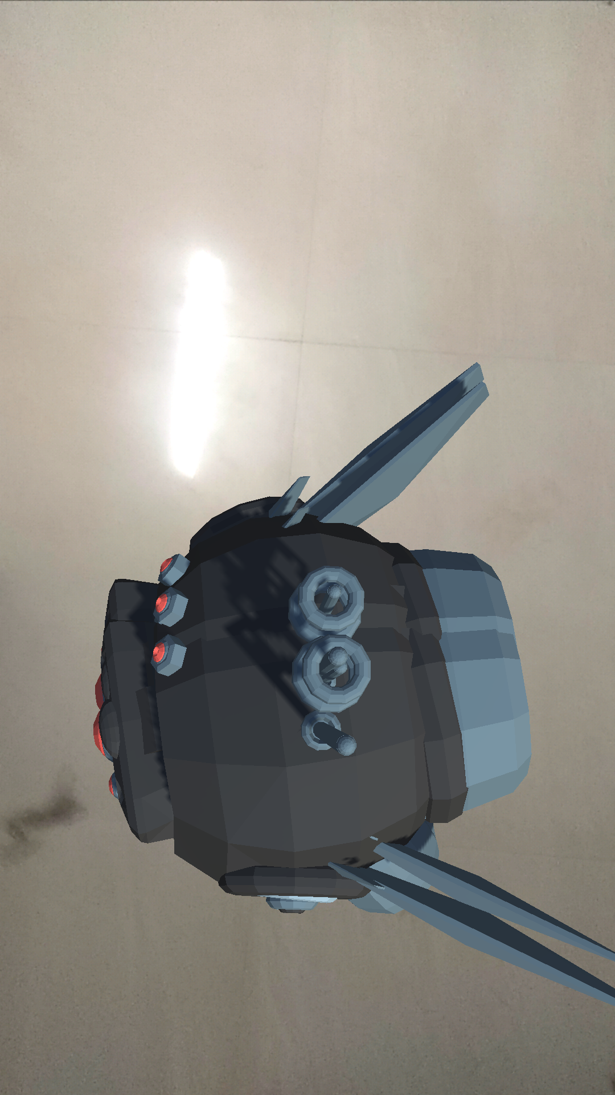
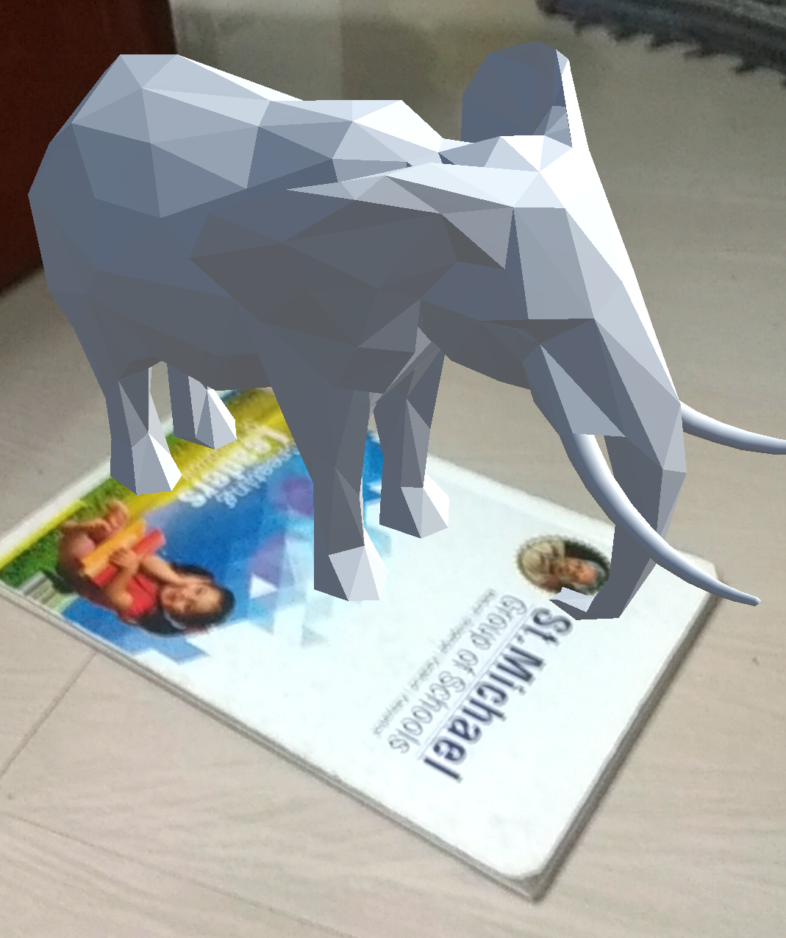
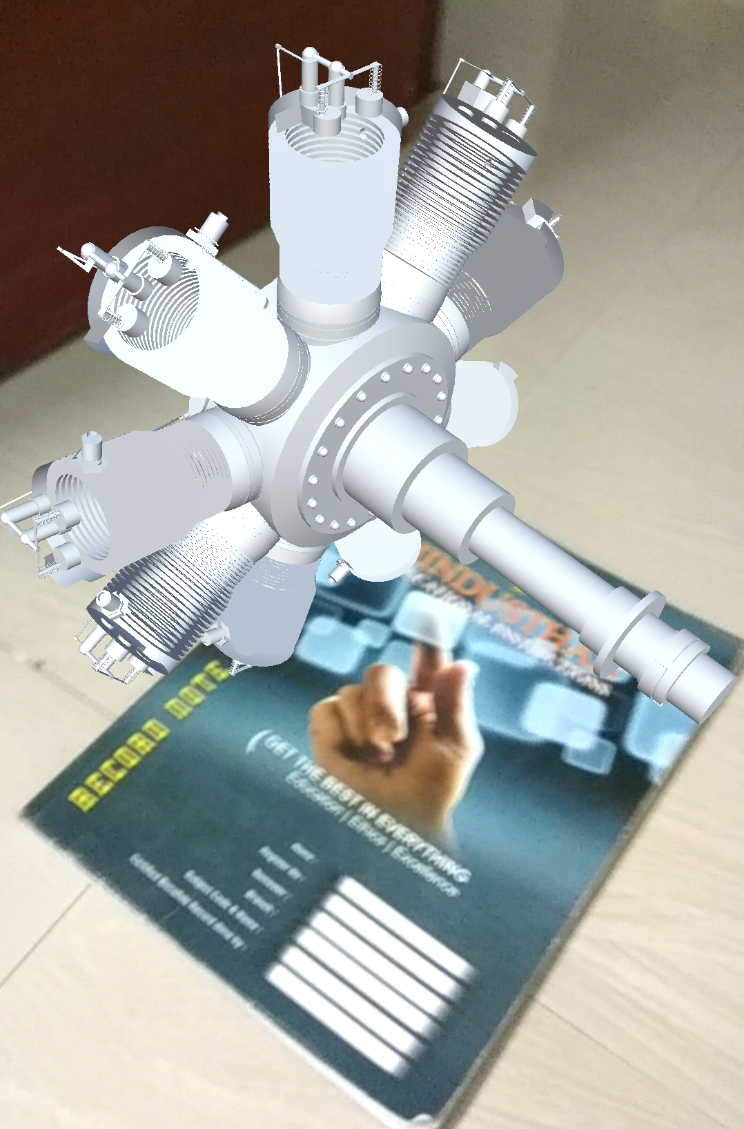
Result

Slide 23
Conclusion
This application can help children with autism to understand things in a way which is comfortable for them.
This application can help the professionals and students to understand complex 3D models.
AR based syllabus from kinder garden children to Engineering Students can be developed.

Slide 24
Future Enhancement
Automatic marking of parts for Engineering models as Augment Reality 3D text with markers targeting specific parts with description.
Touchable Hyperlinks referring to the target model information that opens in a browser.

Slide 25
References
[1] S. C.-Y. Yuen, G. Yaoyuneyong and E.Johnson, “Augmented Reality: An Overview and Five Directions for AR in Education,” Journal of Education Technology Development and Exchange, Vol. 4, no. 1, pp. 119-139.
[2] Gregory Kipper, Joseph Rampolla, “Augmented Reality: An Emerging Technologies Guide to AR,” Syngress/Elsevier Publications 2012.
[3] Metz, Rachel. “Augmented Reality is Finally Getting Real”. MIT Technology Review. N.p., 2016. Web. 24 June 2016.
[4] Simonite, Tom. “Augmented Reality Meets Gesture Recognition”. MIT Technology Review. N.p., 2016. Web. 18 May 2016. [5] Bogle, Ariel. “How the Gurus Behind Google Earth Created.

